Slide 1

NEWS ARTICLE SUMMARIZATION
TEAM:
Akshay Akuthota,
Koushik Sai Guttula

Slide 2
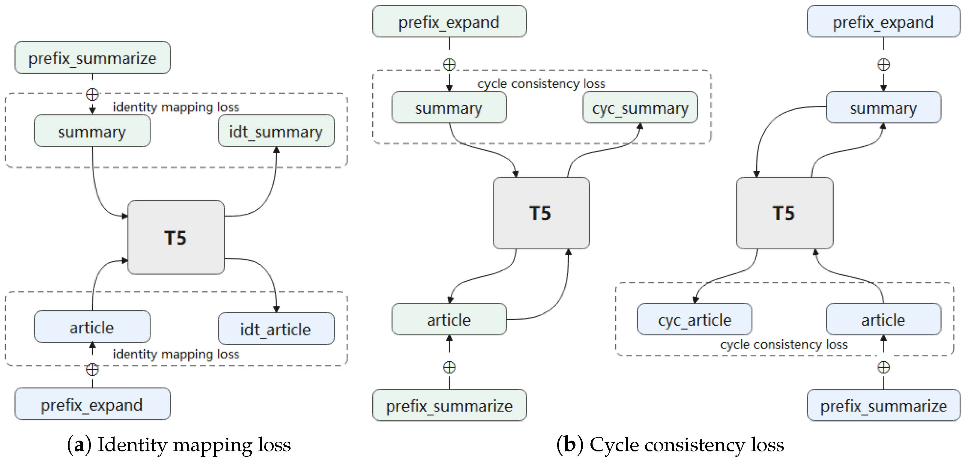
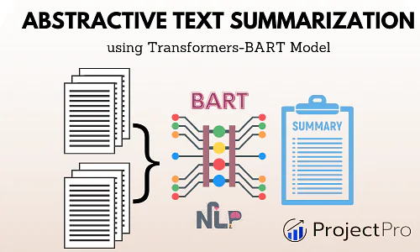
INTRODUCTION
Project Focus: Automated Text Summarization using AI techniques.
Model Used: T5(Text-To-Text Transfer Transformer) developed by Google.
Summarization Type: Abstractive Summarization.

Slide 3

LIBRARIES & TECHNOLOGIES USED
PyTorch
Transformers
Re (Rehex)
Pickle
CUDA/NVIDIA
Trainer API
AutoTokenizer
AutoModelForSeq2SeqLM
Google T5

Slide 4
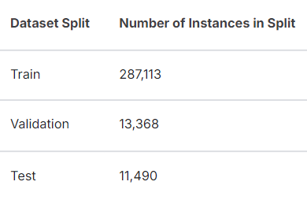
DATASET
We have taken our dataset from kaggle and it is named The CNN / DailyMail Dataset. Link: https://www.kaggle.com/datasets/gowrishankarp/newspaper-text-summarization-cnn-dailymail/data
Each data instance has the following:
id: a string containing the heximal formatted SHA1 hash of the url where the story was retrieved from
article: a string containing the body of the news article
highlights: a string containing the highlight of the article as written by the article author

Slide 5
TRANSFORMER MODELS
bart-large-cnn | t5-small
BART Architecture: BART (Bidirectional and Auto-Regressive Transformers) is a transformer-based model designed for sequence-to-sequence tasks like text generation, summarization, and translation. | T5 (Text-to-Text Transfer Transformer) is a transformer-based model where every NLP task is treated as a text-to-text problem
fine-tuned on the CNN/DailyMail dataset with 400 million parameters, making it highly capable for complex NLP tasks | T5-small is the smallest version of the T5 model, with approximately 60 million parameters, making it more lightweight and faster to train
Developed by Facebook | Developed by Google
Each model has their own tokenizer

Slide 6
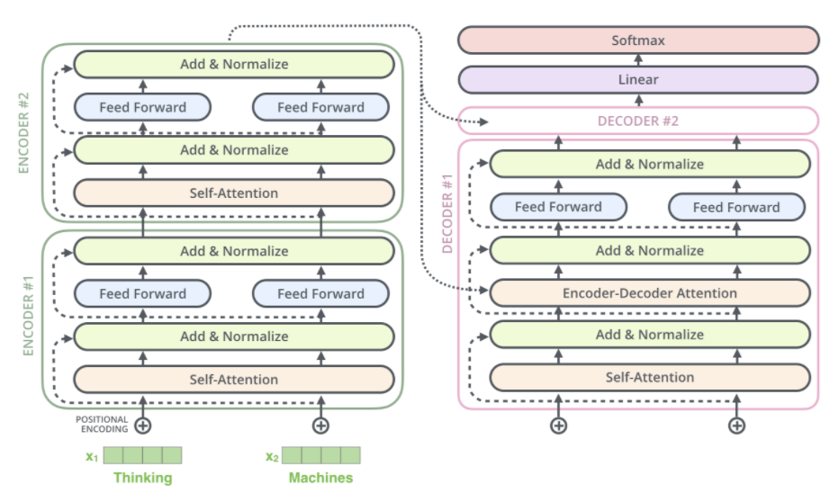
T5 TRANSFORMER MODEL ARCHITECTURE

Slide 7
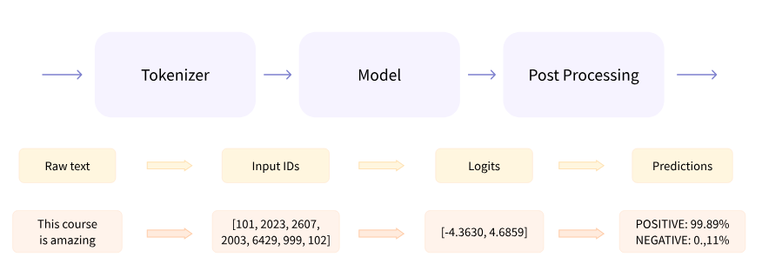
PROJECT PIPELINE

Slide 8
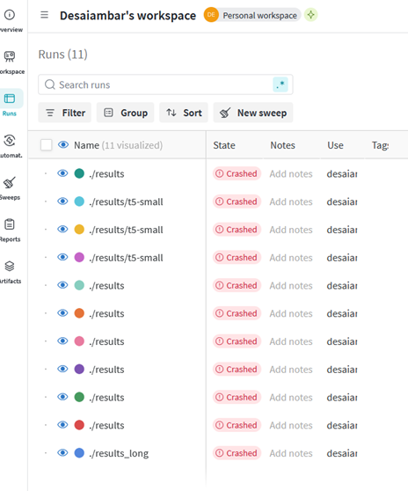

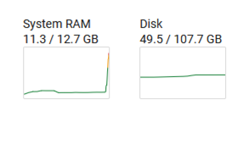
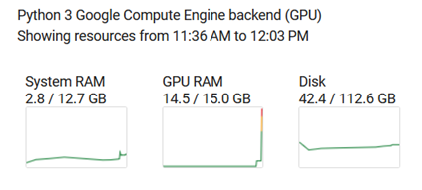
TRAINING MODEL
Pre-requisites
Huggingface account
Weights and Bias account and API key
Training the BART model – crashed every time even on google colab
multiple tried with reduced batch size, token length
different runtimes
The t5-small training worked on google colab but the time required was beyond available free time

Slide 9

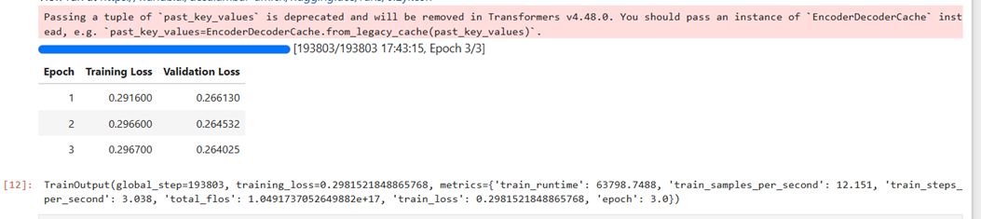
TRAINING MODEL
Finally training worked on local PC
NVIDIA GeForce RTX 3060 6GB
16GB RAM
It took 18 hours!!!

Slide 10
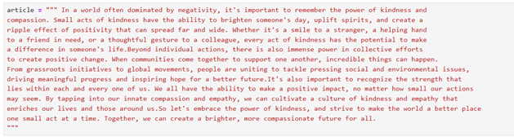
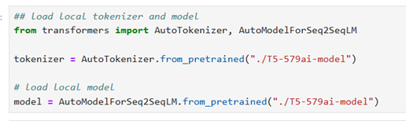
LOCAL TRAINED MODEL
Save locally trained model on local file system
Can query anytime for summary of text

Slide 11
ROUGE SCORE
Recall-Oriented Understudy for Gisting Evaluation
Standard metric in NLP tasks like summarization
Measures how close the generated text is with respect to a reference text
ROUGE-N: Measures the overlap of n-grams
ROUGE-1 unigram (1 word)
ROUGE-2 bigrams (2 word)
ROUGE-L: longest common subsequence (LCS): longest sequence of common words, not required to be consecutive but in order
ROUGE-1 | ROUGE-2 | ROUGE-L
the, cat, the | the cat | the cat the
Ref: The cat is on the mat.
Gen: The cat and the dog.

Slide 12

CHALLENGES FACED
Initially attempted to build the model from scratch using an LSTM-based architecture, but the system crashed due to the large dataset and limited system capabilities.
Explored an LSTM-CNN hybrid model on the cloud, but the generated summaries were incoherent and unusable.
Successfully adopted the T5 Transformer model and fine-tuned it with our dataset, which produced meaningful summaries after approximately 20 hours of training.

Slide 13

CONCLUSION
This news summarization system significantly reduces the time people spend reading lengthy articles by providing clear, concise, and meaningful summaries. It enables quick access to key information, making it easier for individuals to stay informed without compromising on the core details of the news.
Successfully implemented Abstractive Text Summarization using the T5 Transformer Model.
Overcame challenges with initial architectures by adopting a powerful pre-trained model.
Generated meaningful and concise summaries after fine-tuning on the CNN/DailyMail dataset.
Highlighted the potential of AI in automating complex tasks like news summarization.

Slide 14

DEMO VIDEO
https://youtu.be/VqAIjjjHkII?si=TLDUFhojkhh1Wfwj

Slide 15


